Slide 1

Quantum Life AI Development Structure
Presenter: WU Bohuai

Slide 2
1. Introduction

Slide 3
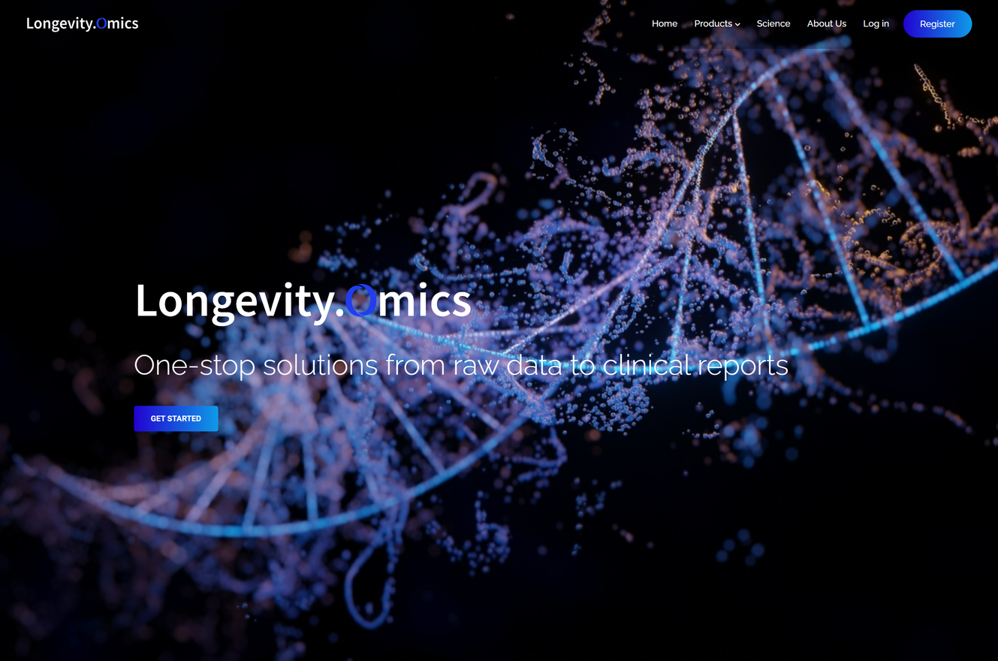
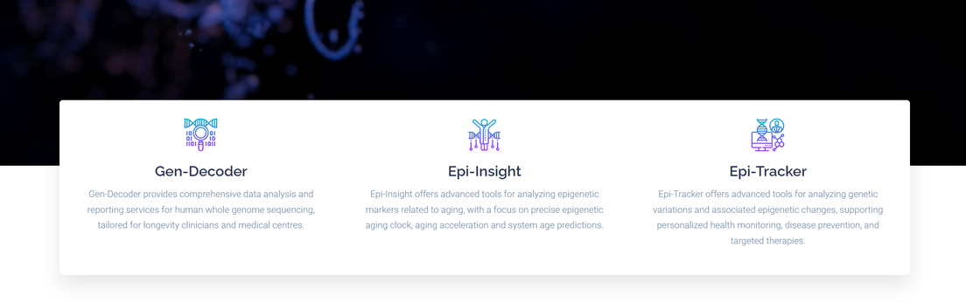
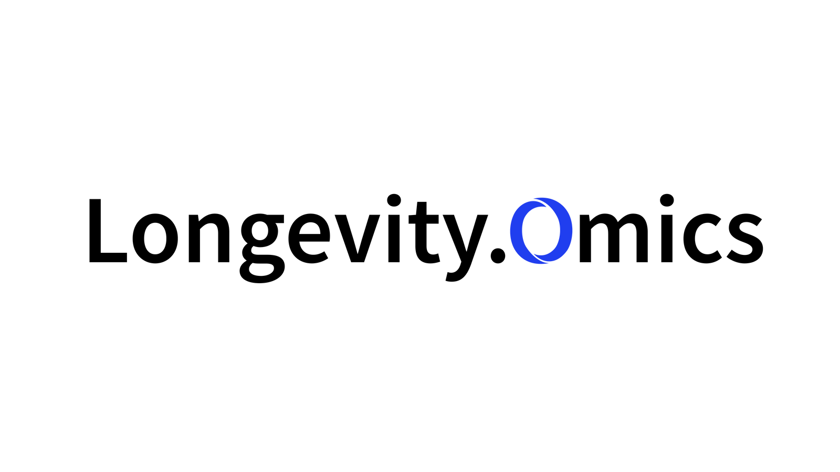
CURRENT PRODUCT SITUATION
Longevity.Omics
one-stop medical solutions from raw multi-omics data to clinical reports to targeted therapies
Services we provide:
Patient Data from Lab/Clinic centers +
Unique Databases and Experts +
Longevity.Omics Analysis
=
Longevity Report
https://longevityomics.tech/

Slide 4
CURRENT PRODUCT SITUATION
Following Information
Background information and comparison between existing medical report and WGS/Epigenetic reports
Elaboration about Whole-Omics Data (what we use)
Explanation about all data we have

Slide 5
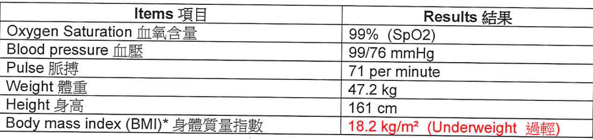
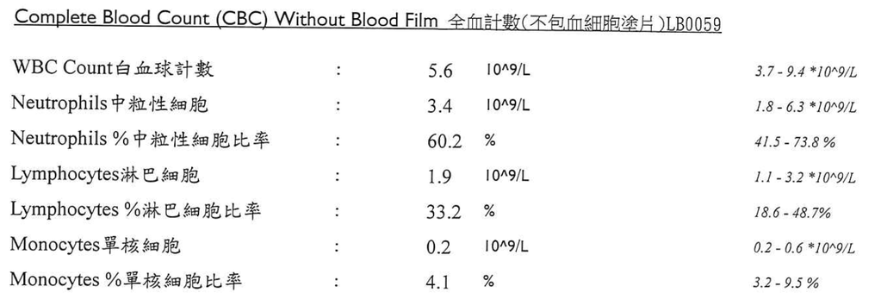
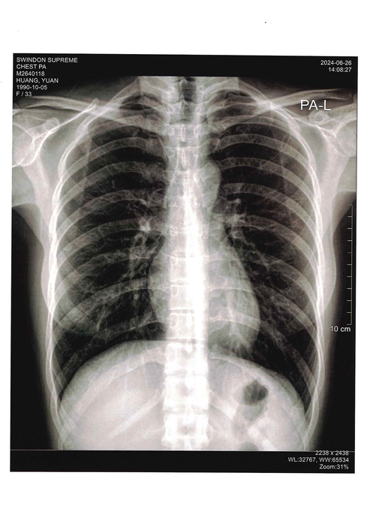
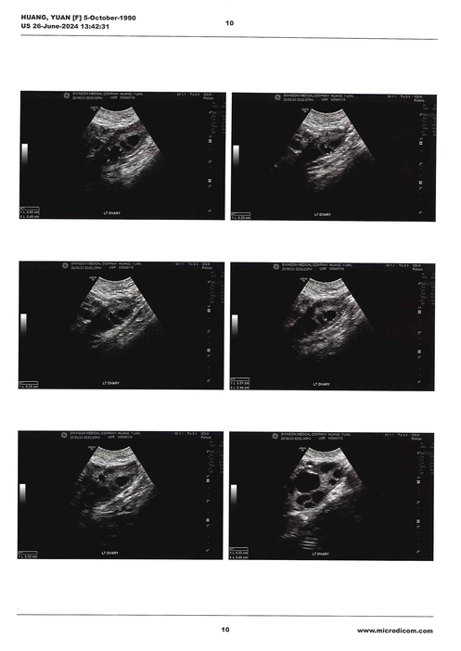
EXISTING MEDICAL REPORT
What is existing medical report?
A traditional medical report summarizes your current health status based on direct measurements and observations, including:
Physical measurements: Height, weight, blood pressure, temperature
Lab test results: Blood work showing things like cholesterol, blood sugar, organ function
Clinical observations: Doctor's findings from physical examination
Patient symptoms: What you tell your doctor about how you feel
Medical history: Past illnesses, surgeries, medications
Existing medical reports focus on what can be directly measured or observed about your health at a specific moment in time.

Slide 6
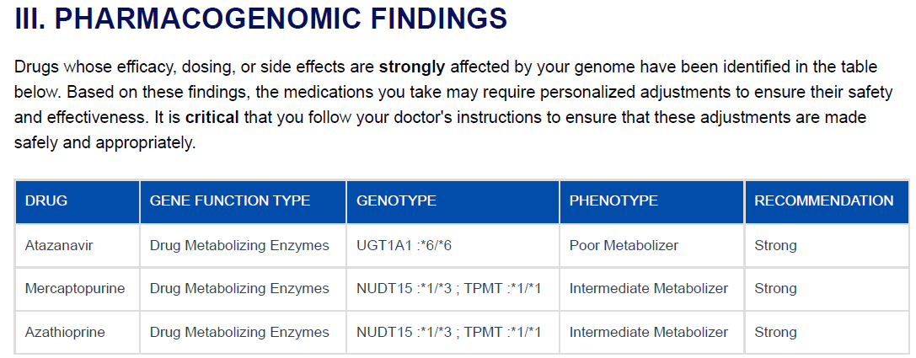
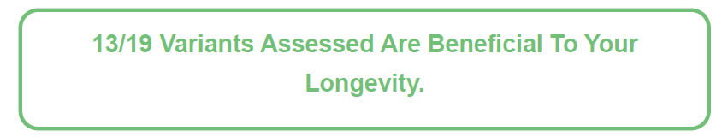
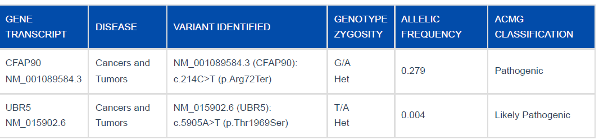
WGS REPORT AND EPIGENETIC REPORT
What is WGS Report?
Our WGS report analyzes your DNA to provide three key insights:
Pharmacogenetics: Shows how your body may react to different medications based on your genes.
Longevity: Examines genes linked to aging and lifespan.
Disease Risk: Identifies genetic variations that might increase your risk for certain diseases or health conditions.
How these analyses are obtained?
We compare your DNA sequences with existing scientific databases to find matches. When we find a match, we report what scientists have already discovered about that specific DNA variation based on previous research and studies.
Pharmacogenetics
Longevity
Disease

Slide 7
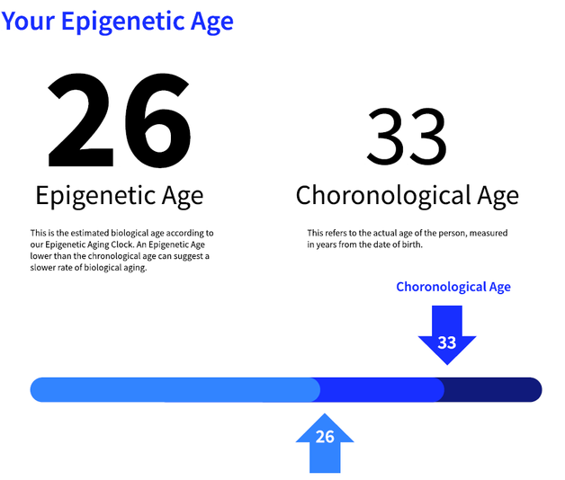
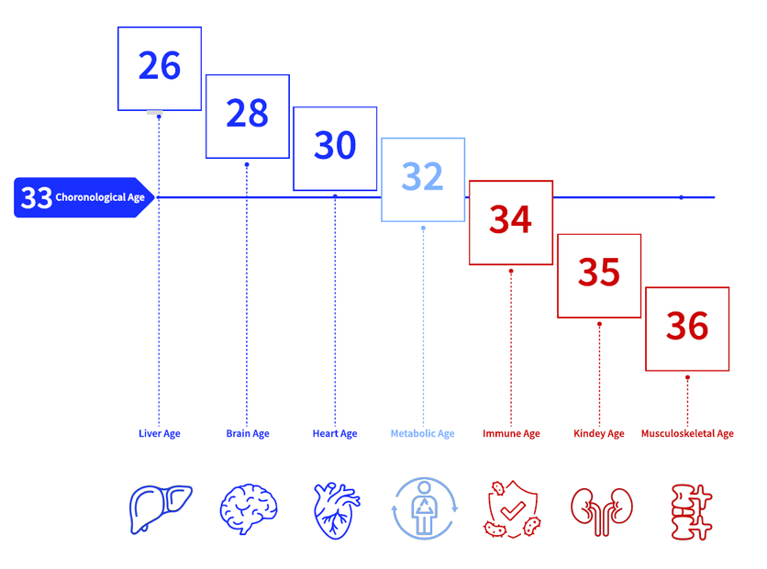
WGS REPORT AND EPIGENETIC REPORT
What is Epigenetic Report?
Our Epigenetic report analyzes your epigenetic age, which is to understand how old your body is, by looking through the methylation.
How these analyses are obtained?
It uses mathematical models to estimate your biological age based on these patterns

Slide 8
WHOLE OMICS DATA VALUE
What is Whole-omics
Whole-omics refers to a comprehensive approach in omics research where the entirety of an organism's omics data is collected and analyzed, e.g., in our case Whole Genome Sequencing and Whole Methylation Profiling (Illumina EPICv2) captures complete genetic and epigenetic landscapes
Significance
Whole-omics provides a complete, continuous genetic and epigenetic snapshot, enabling both real-time insights and retrospective studies for ongoing medical research and personalized treatment strategies.
Whole-Omics vs. Fragmented-Omics
 | Examples | Coverage | Long-Term Utility | Flexibility | Application
Whole-Omics | Whole Genome Sequencing and Whole Methylation Profiling (Illumina EPICv2) | Comprehensive; covers entire genome including non-coding regions and full CpG sites | Continuity Over Time; Data collected today remains relevant for future studies. Allows re-analysis with new scientific questions or technologies without the need for re-sampling | High; allows for retrospective and diverse future studies. | Ideal for comprehensive research and personalized medicine.
Fragmented-Omics | Whole Exome Sequencing, Disease Panels, Customized BeadChips | Targeted; focuses on specific genome regions or CpG sites | Data may quickly become outdated as scientific understanding evolves or as new regions of interest are identified. | Limited to initial research focus and targets. | Suitable for specific clinical diagnostics and research.

Slide 9
DATA BRIEFING
Genetic (variants)
micro/cause
Role: Alterations in the DNA sequence that can influence an individual's susceptibility to various diseases.
Mechanism: Genetic variants can alter protein structure and function, disrupt gene regulation, or influence gene expression levels.
Contribution to Health Outcomes: Provides fixed baseline risk for diseases.
Epigenetic (methylation)
Role: Regulate gene expression without altering the underlying DNA sequence. DNA methylation patterns can be influenced by various factors, including age, lifestyle, and environmental exposures.
Mechanism: Methylation of promoter regions is often associated with gene silencing, while hypomethylation can lead to increased gene expression.
Contribution to Health Outcomes: Count into the environmental factors (aging, lifestyle, ...)
Proteomics
(protein levels)
Role: Proteins are the functional units of cells and play critical roles in various biological processes. Alterations in protein expression, modification, or function can contribute to disease development and progression.
Mechanism: Changes in protein levels or modifications can disrupt cellular processes, leading to disease states.
Contribution to Health Outcomes: Outcome of the genetic/epigenetic information and are the direct cause of disease, improving predictions of disease progression and response to therapy.
Existing Clinical Data (EMR)
Role: EMRs contain historical health data such as blood biomarkers and imaging, crucial for diagnosing and monitoring diseases.
Mechanism: Blood biomarkers reflect the levels of specific molecules, such as proteins, enzymes, or metabolites, which can be indicative of underlying biological processes or disease states.
Contribution to Health Outcomes: From the pathology’s perspective, detect early signs of disease or predict disease progression
macro/outcome

Slide 10
2. AI Discussion

Slide 11
CURRENT PRODUCT SITUATION
Following Information
Current challenge and possible solutions on report generation
Quantum Life AI Stack
3 Steps of AI Models and Possible Goals
Nowcasting
Forecasting
Action

Slide 12
CURRENT DATA ANALYTICAL PROCESS
PharmCat
Data
rearrange and Generate
Pharmacogenomics
Annotation Tool
Longevity
Sequence Alignment
.bam
variant calling
Raw Data
.fastq
fq2bam
Variant
.vcf
Analyze
Quantum Life
Internal Longevity Gene Database
Report
Emedgene
/QCI
Secondary Analysis
Extract genome information from raw data to variant data.
Variant Interpretation Platform
Report Generation
Tertiary Analysis
Need to take into account the patient’s situation and expert’s consideration, which causes huge manual efforts

Slide 13
BOTTLENECK OF CURRENT REPORT GENERATION PIPELINE
Current problem/bottleneck of our report generation pipeline:
Due to the manual selection and review of the results obtained from QCI or Emedgene by our Experts, our report generation system can only process one report each time.
Then according to Queueing Theory,
if we have 1000 reports that need to be processed, and 1 report needs 1 day to process,
then the 1000th report need to wait 1000 days.
Target/Goal:
Keep our efficiency when bunch of reports requirements come.
Transfer as much manual efforts as possible to system analysis.
Possible solutions:
remove QCI analysis -> medical sensitive information
keep QCI but raise prices

Slide 14
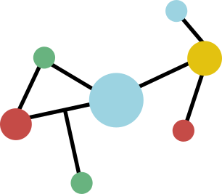

QUANTUM LIFE AI STACK: Q.L.A.I
Outcome Network
Outcomes
Cancer Detection
Cancer Forecasting
Outcome3
...
Methodologies
Regression
CNN
RNN
GNN
Transformer
...
Transfer Learning
Collective Intelligence: Ensamble learning
Supervised Learning
Unsupervised Learning
Reinforcement Learning
LLM
Federated Learning: Nvidia
Discriminative AI
Generative AI
GPU Networks (Cloud)
Multi-Omics Database Foundation
Molecular
Data
Traditional
Electronic Medical Record
Future
Additional Molecular Data
Genomic
Clinical Biomarkers
Proteomics
Epigenomic
Imaging
Metabolomics
Immune cell function

Slide 15
Outcome Network
Outcomes
Cancer Detection
Cancer Forecasting
Outcome3
...
Methodologies
Regression
CNN
RNN
GNN
Transformer
...
Transfer Learning
Collective Intelligence: Ensamble learning
Supervised Learning
Unsupervised Learning
Reinforcement Learning
LLM
Federated Learning: Nvidia
Discriminative AI
Generative AI
GPU Networks (Cloud)
Multi-Omics Database Foundation
Existing
Electronic Medical Record
Future
Multi-Omics Data
Whole-Omics Data
Genomic
Clinical Biomarkers
Proteomics
Epigenomic
Imaging
Metabolomics
Immune cell function

Slide 16

EXAMPLE OF QUANTUM LIFE AI STACK: Q.L.A.I
Outcome Network
Outcomes
Cancer Detection
Cancer Forecasting
Outcome3
...
Methodologies
Regression
CNN
RNN
GNN
Transformer
...
Transfer Learning
Collective Intelligence: Ensamble learning
Supervised Learning
Unsupervised Learning
Reinforcement Learning
LLM
Federated Learning: Nvidia
Discriminative AI
Generative AI
GPU Networks (Cloud)
Multi-Omics Database Foundation
Molecular
Data
Traditional
Electronic Medical Record
Future
Additional Molecular Data
Genomic
Clinical Biomarkers
Proteomics
Epigenomic
Imaging
Metabolomics
Immune cell function

Slide 17
3 STEPS OF OUR AI MODELS
Nowcasting
Forecasting
Action/Intervention
Nowcasting stage (current):
Target is related to the patient current situations (diagnosis): e.g. predict whether the patient suffer from the breast cancer
Forecasting stage (next):
Target is related to predict the future situations of the patient: e.g. risk / onset of suffering from some diseases
Action/Intervention (future):
Target is related to predict some actions to affect the future situations.

Slide 18
NOWCASTING POSSIBLE GOALS
Nowcasting
Forecasting
Action/Intervention
Nowcasting stage possible tasks:
use integrated molecular data and medical data to predict the epigenetic age
use integrated molecular data and medical data to predict more accurate patient health status
knowledge base AI interpretation: https://www.nature.com/articles/s41591-024-03233-x
report digitalization from pdf/images

Slide 19
FORECASTING POSSIBLE GOALS
Nowcasting
Forecasting
Action/Intervention
Forecasting stage:
use integrated whole-omics data and medical data to predict the onset of a disease
Action/Intervention stage
use integrated whole-omics data and medical data to predict the healthy/intervention actions for the patient

Slide 20
FORECASTING STAGE STRATEGY
Our strategy:
Given expected outcomes, regress to the type and quantity of data we need.
Details:
Set up one prediction target: e.g. predict onset of suffering cancer according to current situation.
Generate synthetic data for this target:
temporal-spatial inferences
temporal -> longitude data
spatial -> different datasets
using LLM’s existing medical knowledge + Medical reports/records + Additional knowledges
Given a patient situation
ask LLMs the patient situation after 3 years, 5 years...
Use existing Deep learning models to predict the target outcome.
Monitor the prediction performance and go back to step 2 to adjust the amount of data synthesized and the types of the data until the prediction performance is fit our expectation.
Now we know what types and quantity of data we need to get to the target.

Slide 21
BORROWING/PURCHASING DOCTRINE
Our purpose is: establish the AI system as soon as possible
3 ways to build the AI models:
Cloud AI Services
Outsourcing AI companies in HKSTP or Shenzhen to build some models
PhD students
We then build the whole AI system on the server/cloud we select.

Slide 22
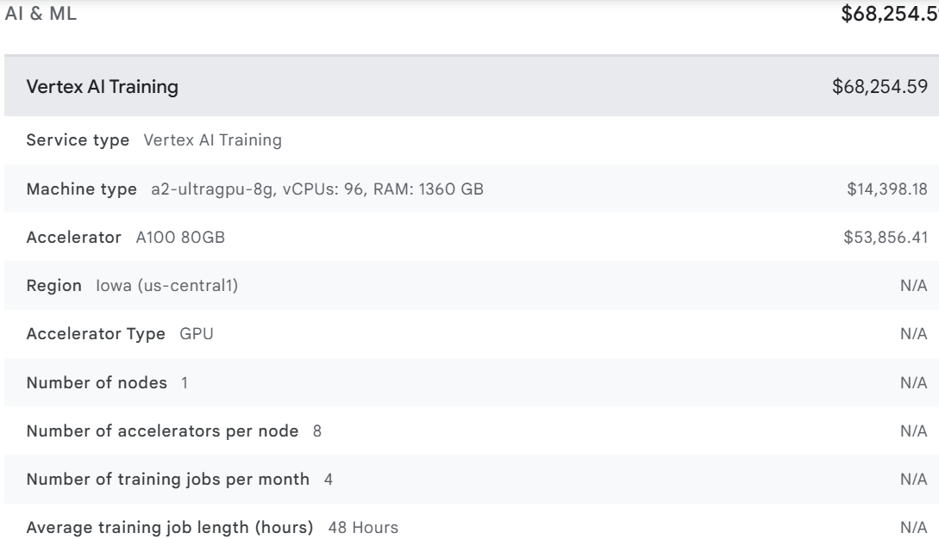
COST ESTIMATION
Cloud AI Services
Google Cloud Vertex AI
Training cost ~70000 hkd/month
1 full-time AI scientist
Alibaba Cloud
Outsource AI models
need to inquiry
Cloud Deployment
google cloud vertex ai: ~9000 hkd/month

